Slide 1


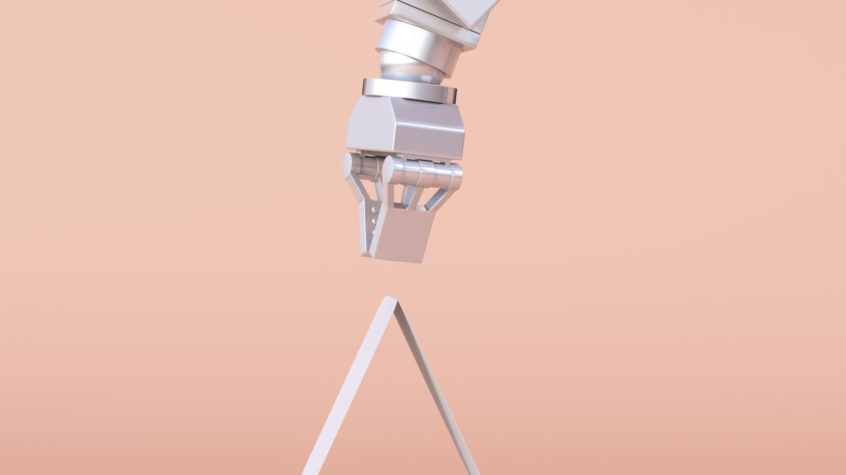

PROJECT : CAMERA SURVEILLANCE CAR WITH PAN TILT CONTROL Robotics and Automation Digital Assignment -2
Team Members-
21BEC1469-Atmadeep Banerjee
21BEC1832-Kaushiki Choudhuri
21BEC1206-Mohit Praharaj
21bec1638-Manav Balodi

Slide 2

AIM/OBJECTIVE OF THE PROJECT
The objective of the project is to make a camera surveillance car.
Concept/Methodology
In this project we will made a camera surveillance car with pan tilt control, in which the camera is attached with a pan tilt servo base that rotates 180 degrees in the vertical as well as the horizontal direction. The microcontroller board will be used to program the car was Arduino Uno, which contains ATmega328P as the microprocessor. The camera will be used to record the background of the car was a ESP32 Cam Module, which is a WI-FI camera module that can transmit the visual feed through the internet connection and the visual feed can be observed in the online web browser by connecting with the IP address of the ESP32 Cam Module. The movement of the car could be controlled by the user in four different directions – front, back, left and right. The interpretation of the movement instructions and the execution of the movement of the car will be enable by the microcontroller board Arduino Uno.

Slide 3

Components :
1. MICROCONTROLLER BOARD
ARDUINO UNO R3
( MICROPROCESSOR – Atmega328P )
2. WIFI CAMERA AND
DEVELOPMENT BOARD
OV2640 CAMERA MODULE
ESP32 CAM WIFI BLUETOOTH
DEVELOPMENT BOARD
3. BREADBOARD
400 TIES SOLDERLESS BREADBOARD
4. MOTOR DRIVER
L298N MOTOR DRIVER CONTROLLER
MODULE
5. BATTERY LITHIUM POLYMER BATTERY PACK
• NUMBER OF CELLS : 2
6. CAR CHASSIS AND ASSEMBLY PACK
4 WHEELED CAR CHASIS + 4 DC MOTORS
( 5V DC MOTOR ) WITH WHEEL ENCODER + 4 CASTOR WHEELS + M2 SCREWS + 4 SPACERS
7. PAN TILT SERVO ASSESBLY
PAN/TILT CAMERA PLATFORM WITH 2-AXIS FPV ( FIRST PERSON VIEW )
8. SERVO MOTOR
SG90 MICRO SERVO MOTOR
9. JUMPER WIRES
• MALE TO MALE
• FEMALE TO FEMALE
• MALE TO FEMALE
10. T PLUG MALE CONNECTOR
DEANS STYLE T PLUG MALE CONNECTOR

Slide 4
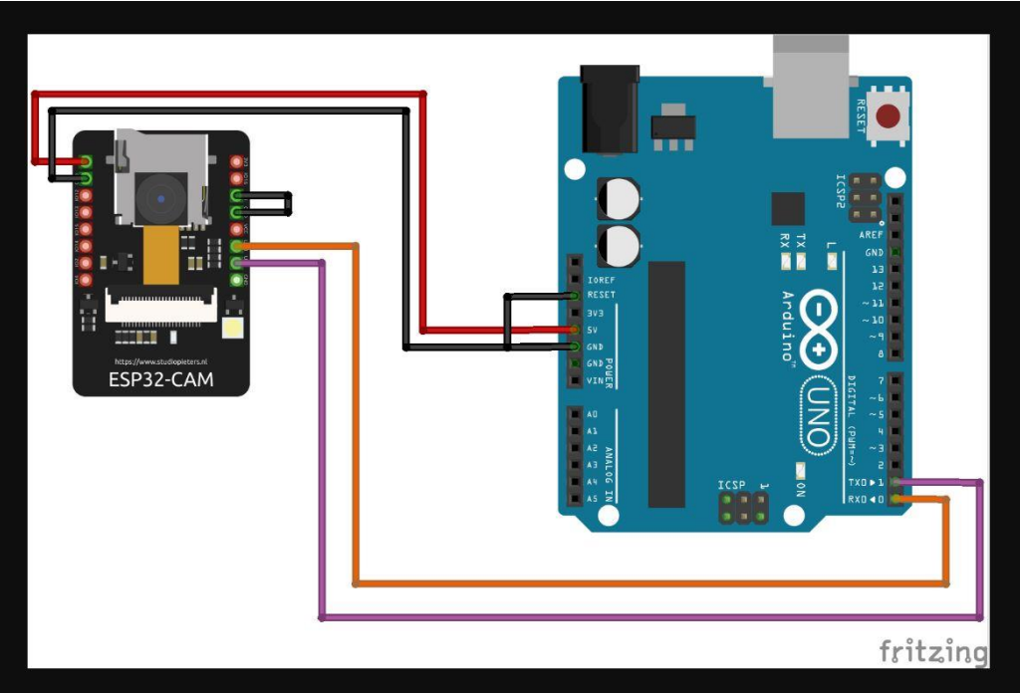
CIRCUIT DIAGRAM AND COMPONENTS DESCRIPTION CIRCUIT DIAGRAM
Circuit diagram for uploading the Arduino code from the software in the laptop to the microcontroller board and then to the ESP32 Cam Module through breadboard connections.

Slide 5
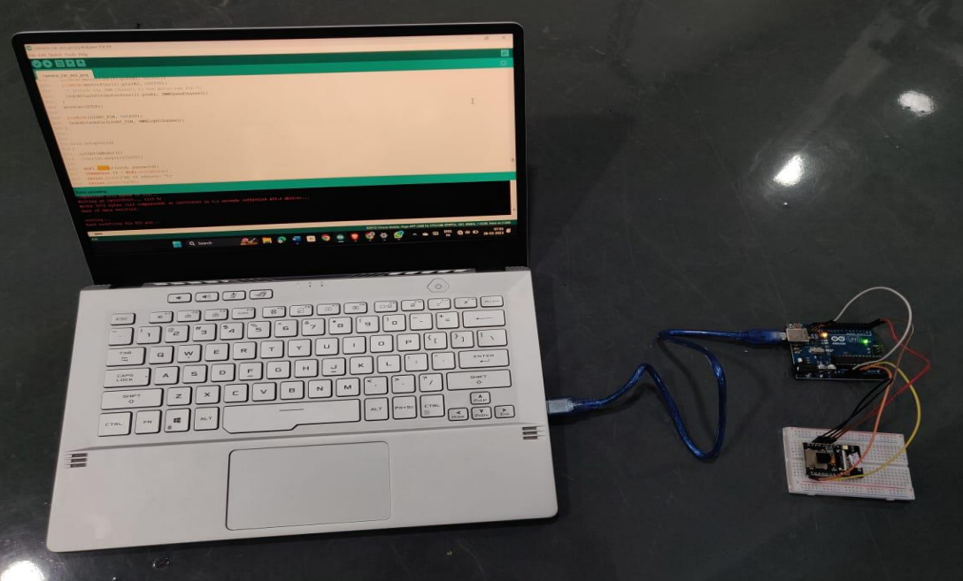
Code uploading to the ESP32 Cam module

Slide 6
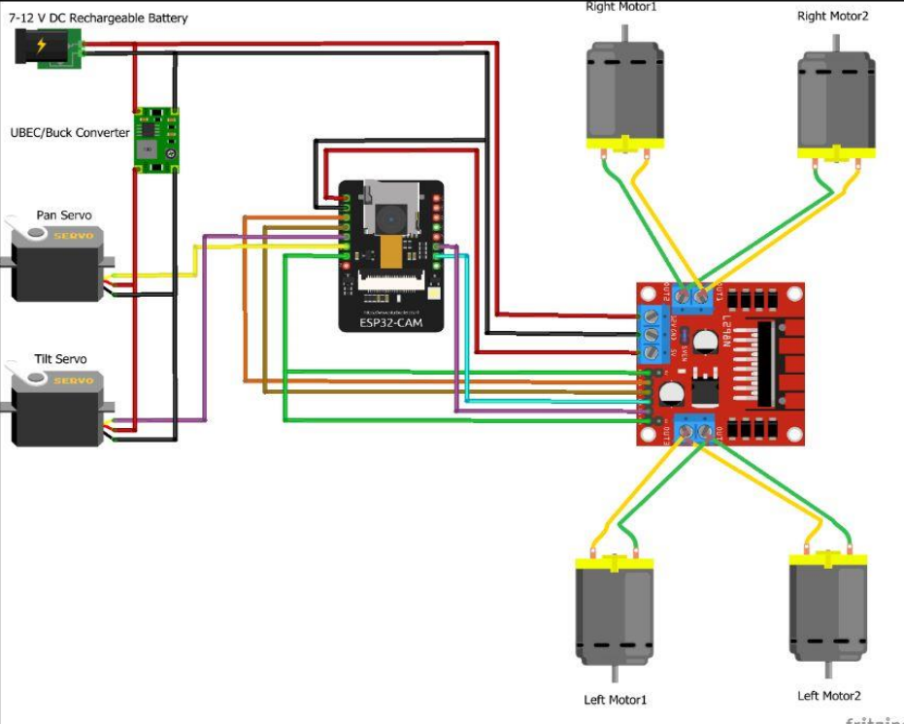
Circuit diagram for assembling the entire car

Slide 7
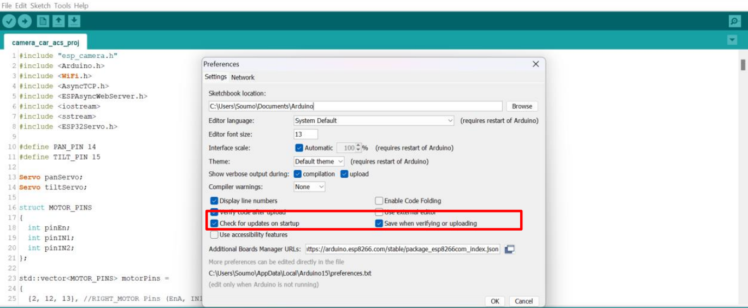
SOFTWARE METHODOLOGY
1. To install the ESP32 board in arduino ide we added the url for the json files in the space provided for additional board manager urls.

Slide 8
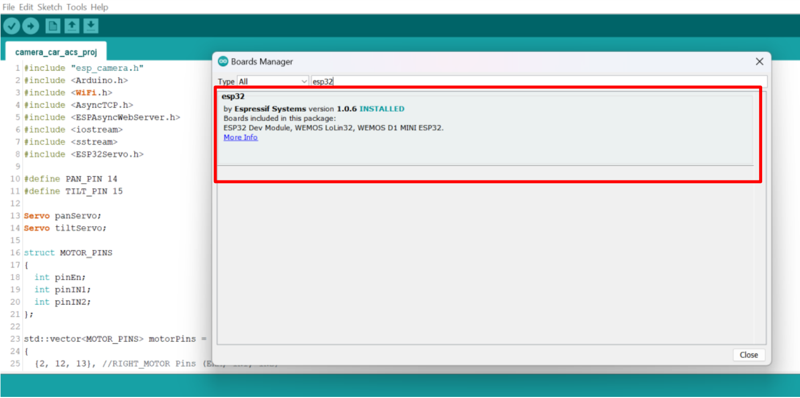
2. We installed the ESP32 board by going to the boards manager window under the tools section.

Slide 9
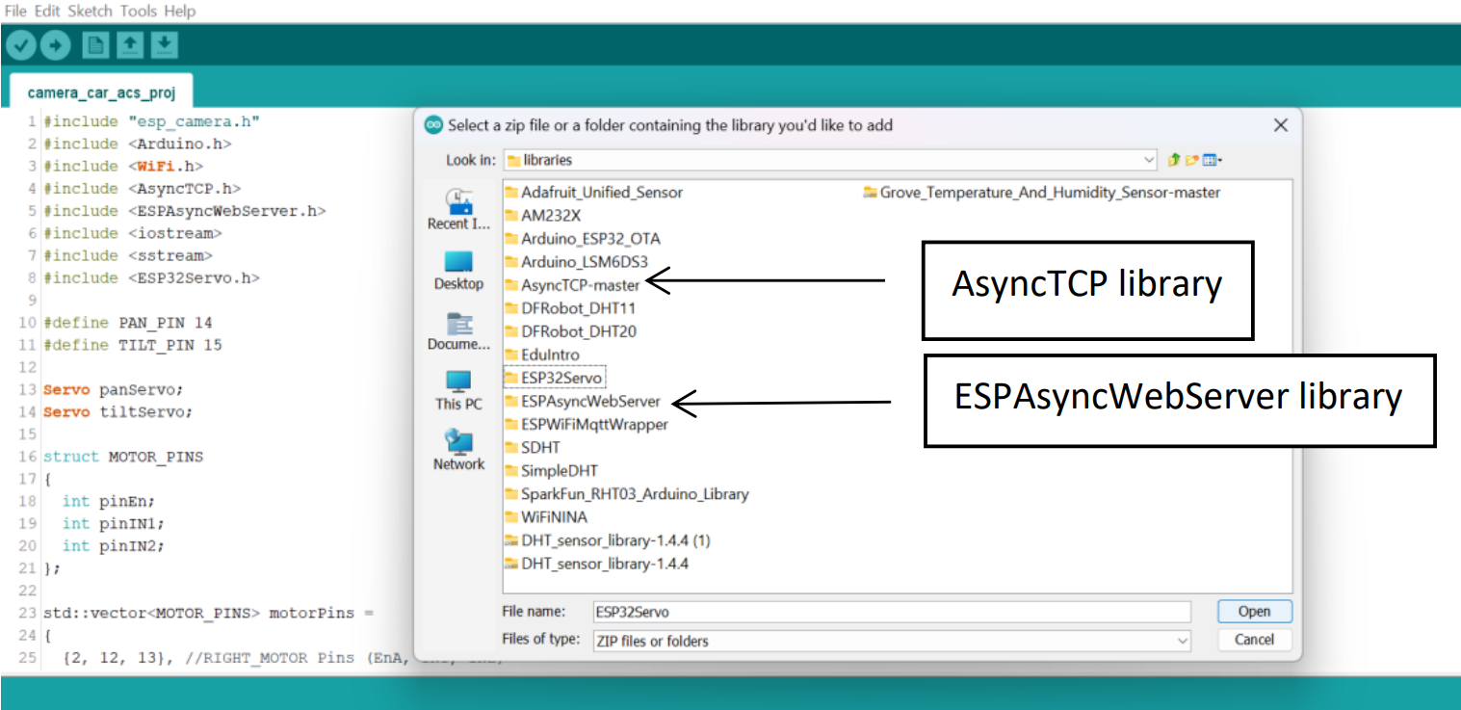
3. We installed two libraries (AsyncTCP and ESPAsyncWebServer). The AsyncWebServer library helps us to get the visual feed from the camera through the wifi connection. The AsyncTCP library generates the ip address of the web socket of the ESP32 Cam Module.

Slide 10
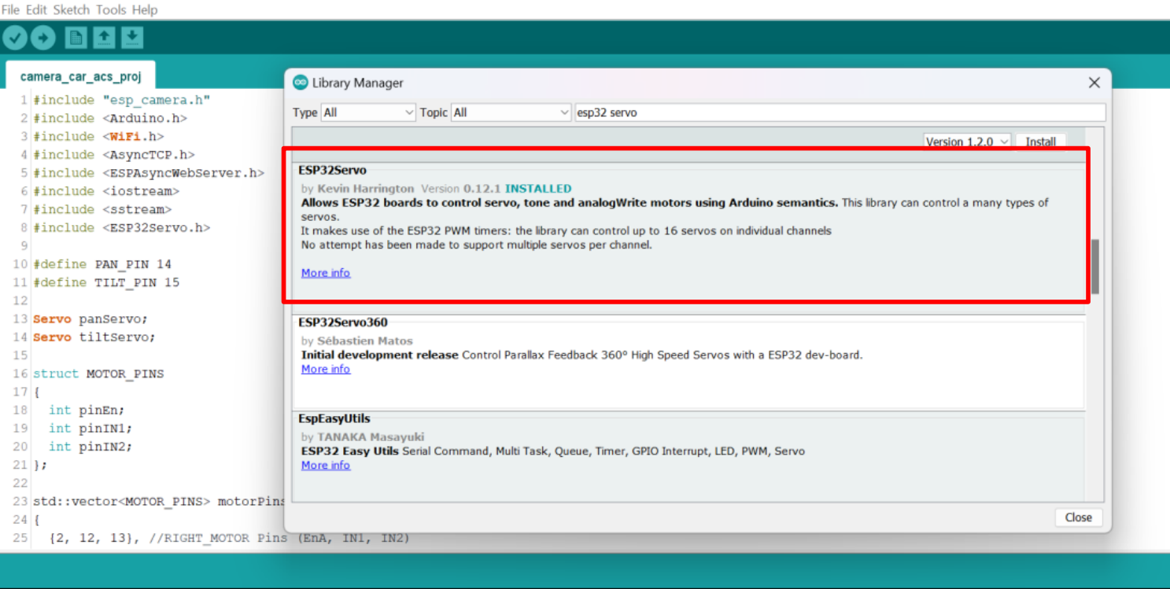
4. We installed ESP32 servo library from the Ardruino library manager.

Slide 11
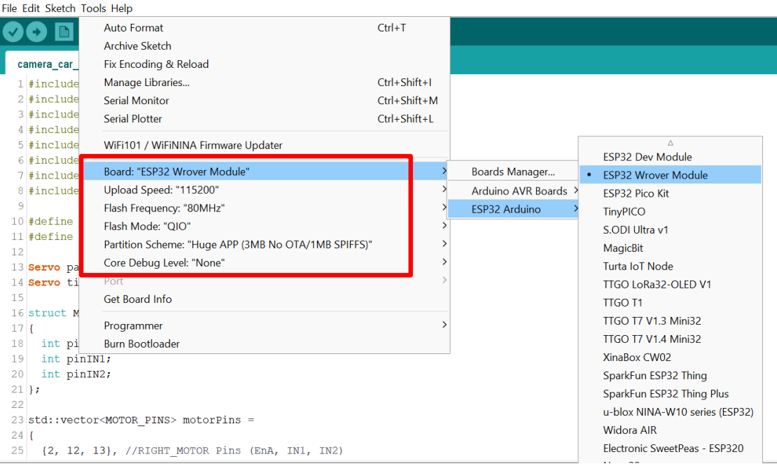
We setup the ardruino IDE to run ESP32 module where we choose the board as the ESP32 Wrover Module, the upload speed as 115200, flash frequency as 80 MHz, flash mode as QIO, partition scheme as “ Huge APP ( 3MB No OTA/1M8 SPIFFS”, and the core debug level as none.

Slide 12
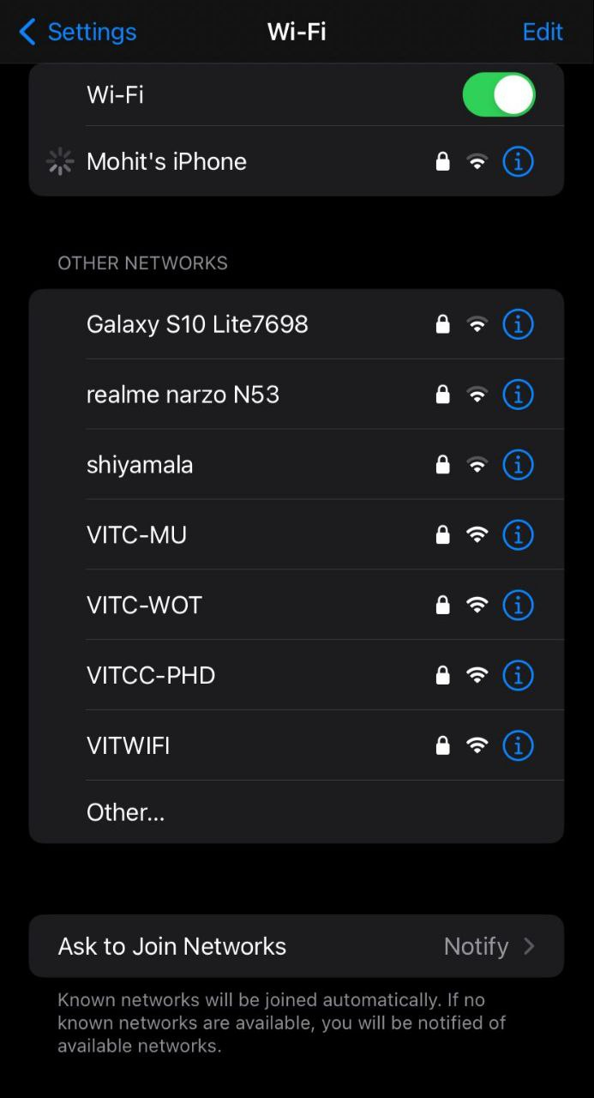
RESULTS AND DISCUSSION
Connecting mobile to the ESP32 WIFI board: We type the ip address in the online web browser as 192.168.4.1.This ip address transfers the online visual feed of the camera and displays it in the web browser, alongwith rotation of the servo motor. The name of the wifi sssd is Mohit’s iPhone, password for connecting is xxxxxxx.

Slide 13
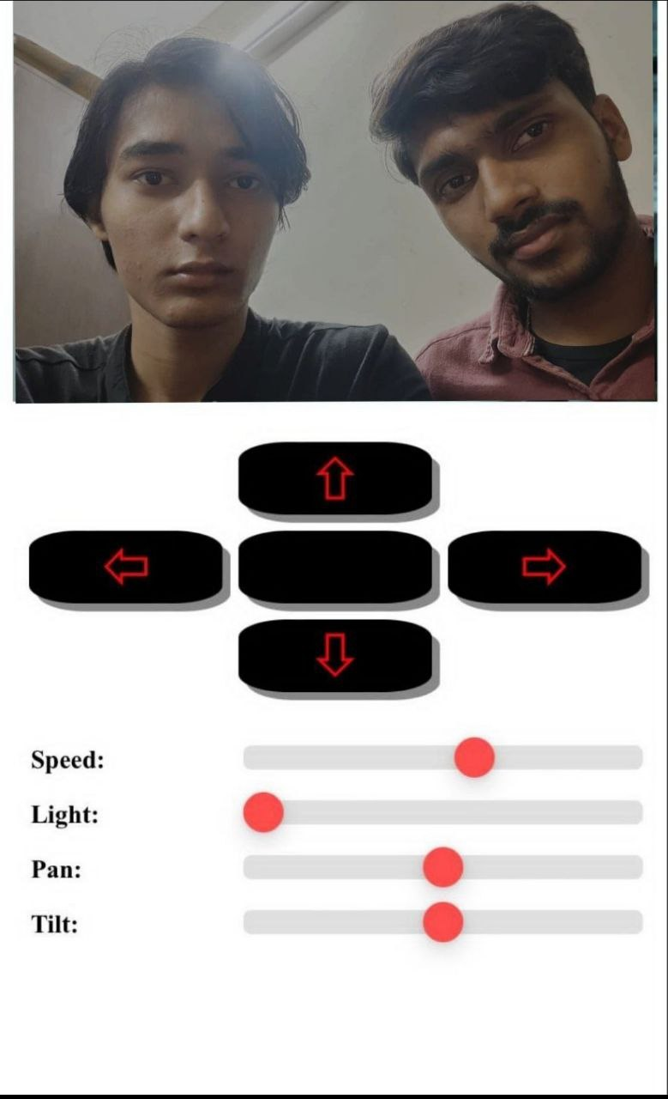
Web socket’s IP address-192.168.4.1
Camera feed from ESP32 CAM.
Buttons(forward,left ,right,back).
To increase the brightness of the camera feed.
To change the angle of the servo motors in the pan tilt assembly.

Slide 14
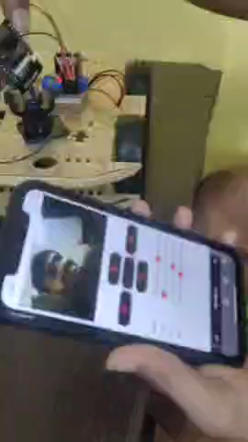
Video of testing while ESP32 CAM is connected to the WiFi and sending real time images to the connected device .

Slide 15
Outcomes of the project
1. A camera surveillance automobile with user-controlled floor movement has been successfully built.
2. Integrated a pan tilt servo base that can rotate 180 degrees in both the horizontal and vertical directions to provide 360 degrees of coverage.
3. Using an Arduino Uno microcontroller board, movement control was implemented to enable exact user engagement.
4. Installed Wi-Fi connectivity to send live video from the cameras to a web browser online, allowing for remote viewing through the tracking of the cameras' IP addresses.
5. The project's goal of developing a user-controlled, widely-covering, and adaptable surveillance system was accomplished.

Slide 16

CONCLUSION
In this project we have made a camera surveillance car with pan tilt control. We navigated through an unknown environment by using the camera feed from ESP32 cam and displayed it on a web page. On web page we had 4 buttons (forward ,left, right, back) which helped used to control the car’s movement in the new and unknown environment. We also had 4 sliders on web page to change the angle of the servo so that we could get a wider field of view and survey the entire area.

Slide 17

REFERENCES
Entire project:
https://www.youtube.com/watch?v=tyY7AN132Xs
Surveillance car assembly
https://www.youtube.com/watch?v=HfQ7lhhgDOk
Servo Pan tilt control assembly
https://www.youtube.com/watch?v=Rm_R0MAmHHA
Camera connection Diagram
https://github.com/un0038998/CameraCar/tree/main/Diagrams
Pan tilt control Diagram
https://github.com/un0038998/CameraCarWithPanTiltControl
Ardruino UNO R3 Datasheet
https://docs.arduino.cc/resources/datasheets/A000066-datasheet.pdf
Motor Driver Datasheet
https://www.sparkfun.com/datasheets/Robotics/L298_H_Bridge.pdf
Car chassis assembly
https://www.youtube.com/watch?v=Ze4c_a3luqg

